Slide 1

Walmart Transaction Fraud Detection System Domain: Marketing & Business
Zeroth Review
Course Code: CS6510
Course Title: Project 1
Register Number:23MSP3032
Name:S.P.Dhinesh
Date:16.11.2023

Slide 2
Problem Statement
This study aims to develop a robust machine learning model to predict Walmart’s fraud transaction.
Walmart faces challenges associated with transaction fraud, where malicious actors attempt to make unauthorized or deceitful purchases. Fraudulent transactions can lead to financial losses for both Walmart and its customers, damage to the company's reputation, and potential legal issues. The task is to create a system that can effectively distinguish between legitimate and fraudulent transactions, providing a secure shopping experience for customers..

Slide 3
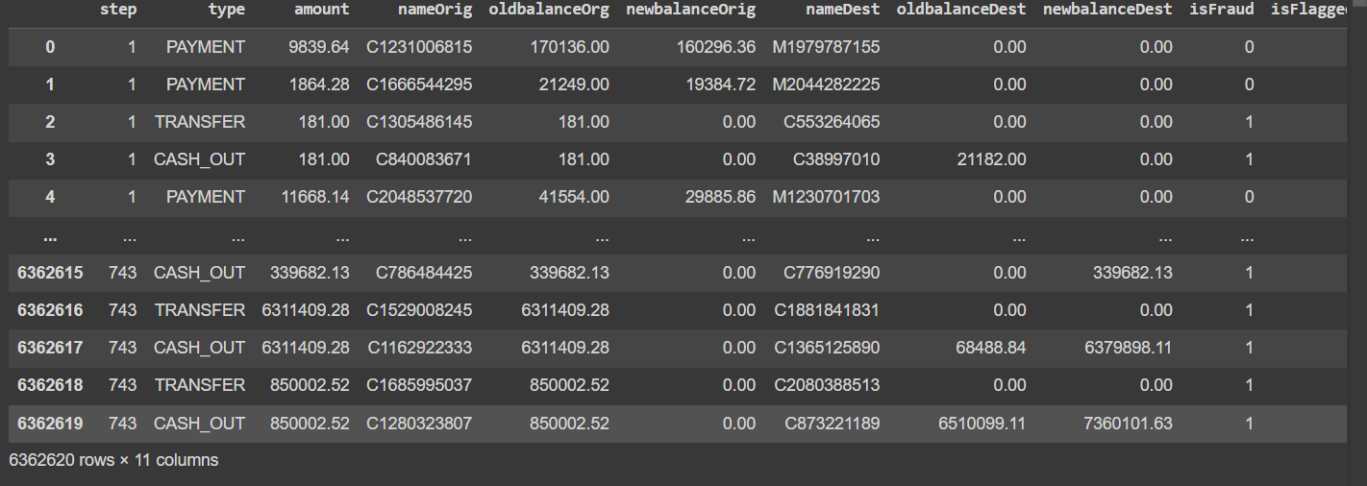
Dataset
Source of the Dataset: Walmart fraud detection (kaggle.com)
No. of Observations:6362604
Column/Feature Details:
Screenshot of the dataset:
Store: The identifier of the Walmart store.
Date: The date on which the recorded data pertains.
Temperature: The temperature on the given date, likely in degrees Fahrenheit.
Fuel_Price: The cost of fuel, potentially influencing transportation and logistics.
MarkDown1 - MarkDown5: These columns represent different types of promotional markdowns. The exact nature of each markdown type isn't specified in the data.
CPI: The Consumer Price Index, indicating the average price level for goods and services.
Unemployment: The unemployment rate at the time the data was recorded.
IsHoliday: A boolean indicating whether the date was a holiday.

Slide 4
Review of Related Literature
Base Paper:
Dr. C. Shyamala, P. Sabarish, T. Vignesh, S. Yogeendran. 2021 WALMART Fraud Detection using MACHINE LEARNING ALGORITHMS. , K.Ramakrishnan College of Technology Retrieved from Semantic Scholar.
Paper I:
R. Bajaj et al., "WALTS: Walmart AutoML Libraries, Tools and Services," 2022 48th Euromicro Conference on Software Engineering and Advanced Applications (SEAA), Gran Canaria, Spain, 2022, pp. 21-28, doi: 10.1109/SEAA56994.2022.00013.
WALTS: Walmart AutoML Libraries, Tools and Services | IEEE Conference Publication | IEEE Xplore
Paper II:
M. V. Ramasami, R. Thangaraj, S. Manoj Kumar and S. Eswaran, "Exploratory Data Analysis of Walmart Outlets Sales using Data Analytics Techniques," 2023 International Conference on Digital Applications, Transformation & Economy (ICDATE), Miri, Sarawak, Malaysia, 2023, pp. 1-4, doi: 10.1109/ICDATE58146.2023.10248586.
Exploratory Data Analysis of Walmart Outlets Sales using Data Analytics Techniques | IEEE Conference Publication | IEEE Xplore
Paper III:
S. B. Latha, C. Dastagiraiah, A. Kiran, S. Asif, D. Elangovan and P. C. S. Reddy, "An Adaptive Machine Learning model for Walmart sales prediction," 2023 International Conference on Circuit Power and Computing Technologies (ICCPCT), Kollam, India, 2023, pp. 988-992, doi: 10.1109/ICCPCT58313.2023.10245029.
An Adaptive Machine Learning model for Walmart sales prediction | IEEE Conference Publication | IEEE Xplore
Paper IV:
Z. Qiao, "Walmart Sale Forecasting Model Based On LightGBM," 2020 2nd International Conference on Machine Learning, Big Data and Business Intelligence (MLBDBI), Taiyuan, China, 2020, pp. 76-79, doi: 10.1109/MLBDBI51377.2020.00020.
Walmart Sale Forecasting Model Based On LightGBM | IEEE Conference Publication | IEEE Xplore

Slide 5
Impact of the Proposed Research
The proposed research on predicting Walmart’s transaction fraud detection using machine learning is poised to significantly enhance forecasting accuracy, leading to strategic inventory management and refined promotional strategies.
The user-friendly interface for security teams, coupled with detailed dashboards and reports, facilitates effective monitoring of the fraud detection system. This enables security personnel to make informed decisions and further optimize the system based on performance metrics.
The system's ability to block or flag suspicious accounts and transactions proactively mitigates risks before they escalate. This proactive approach aligns with industry best practices for risk management in the retail sector.

